Slide 1

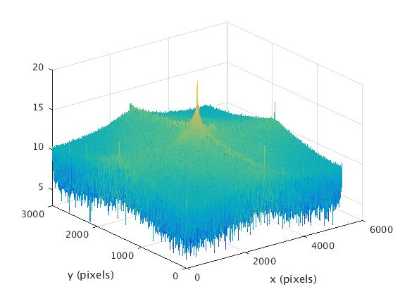
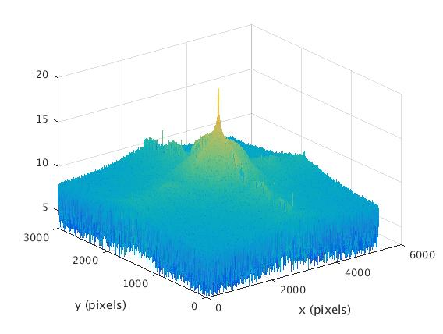
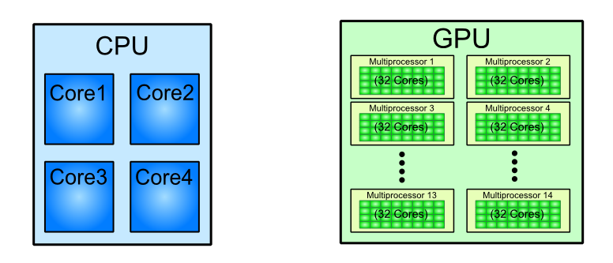
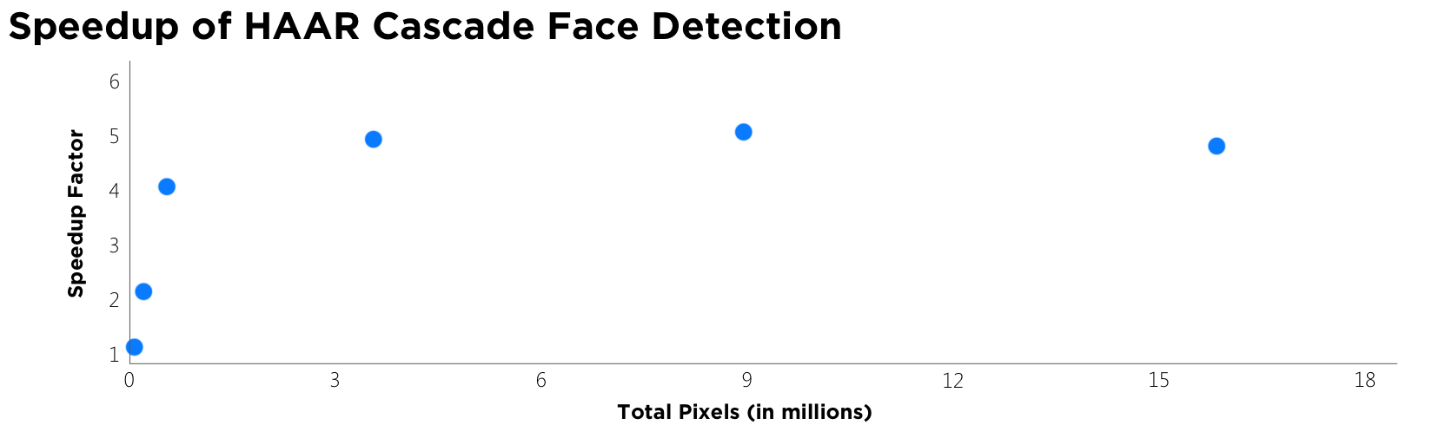
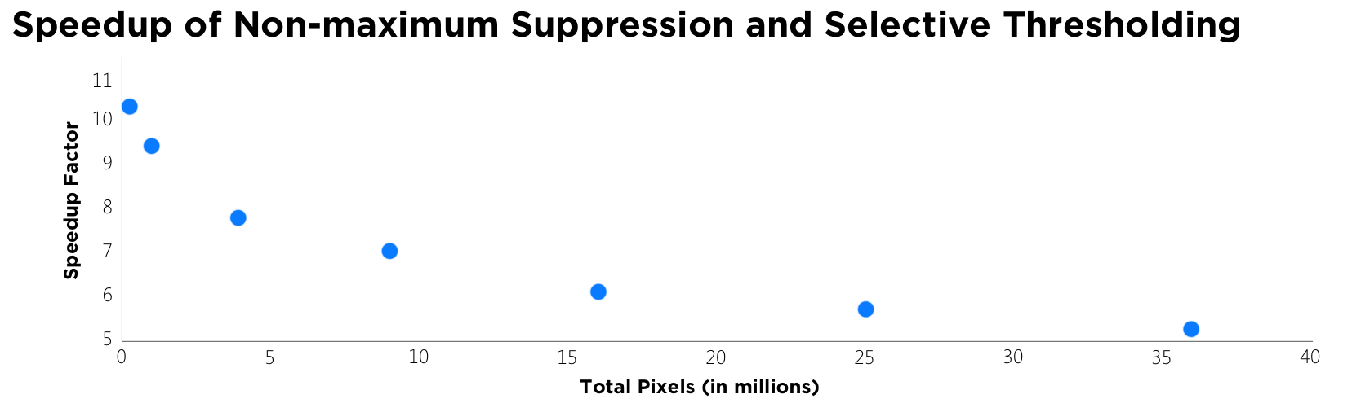
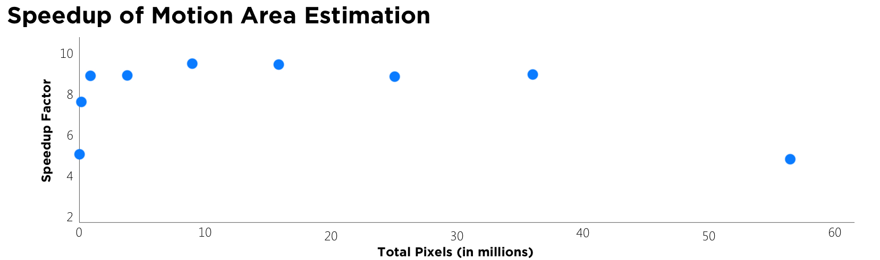
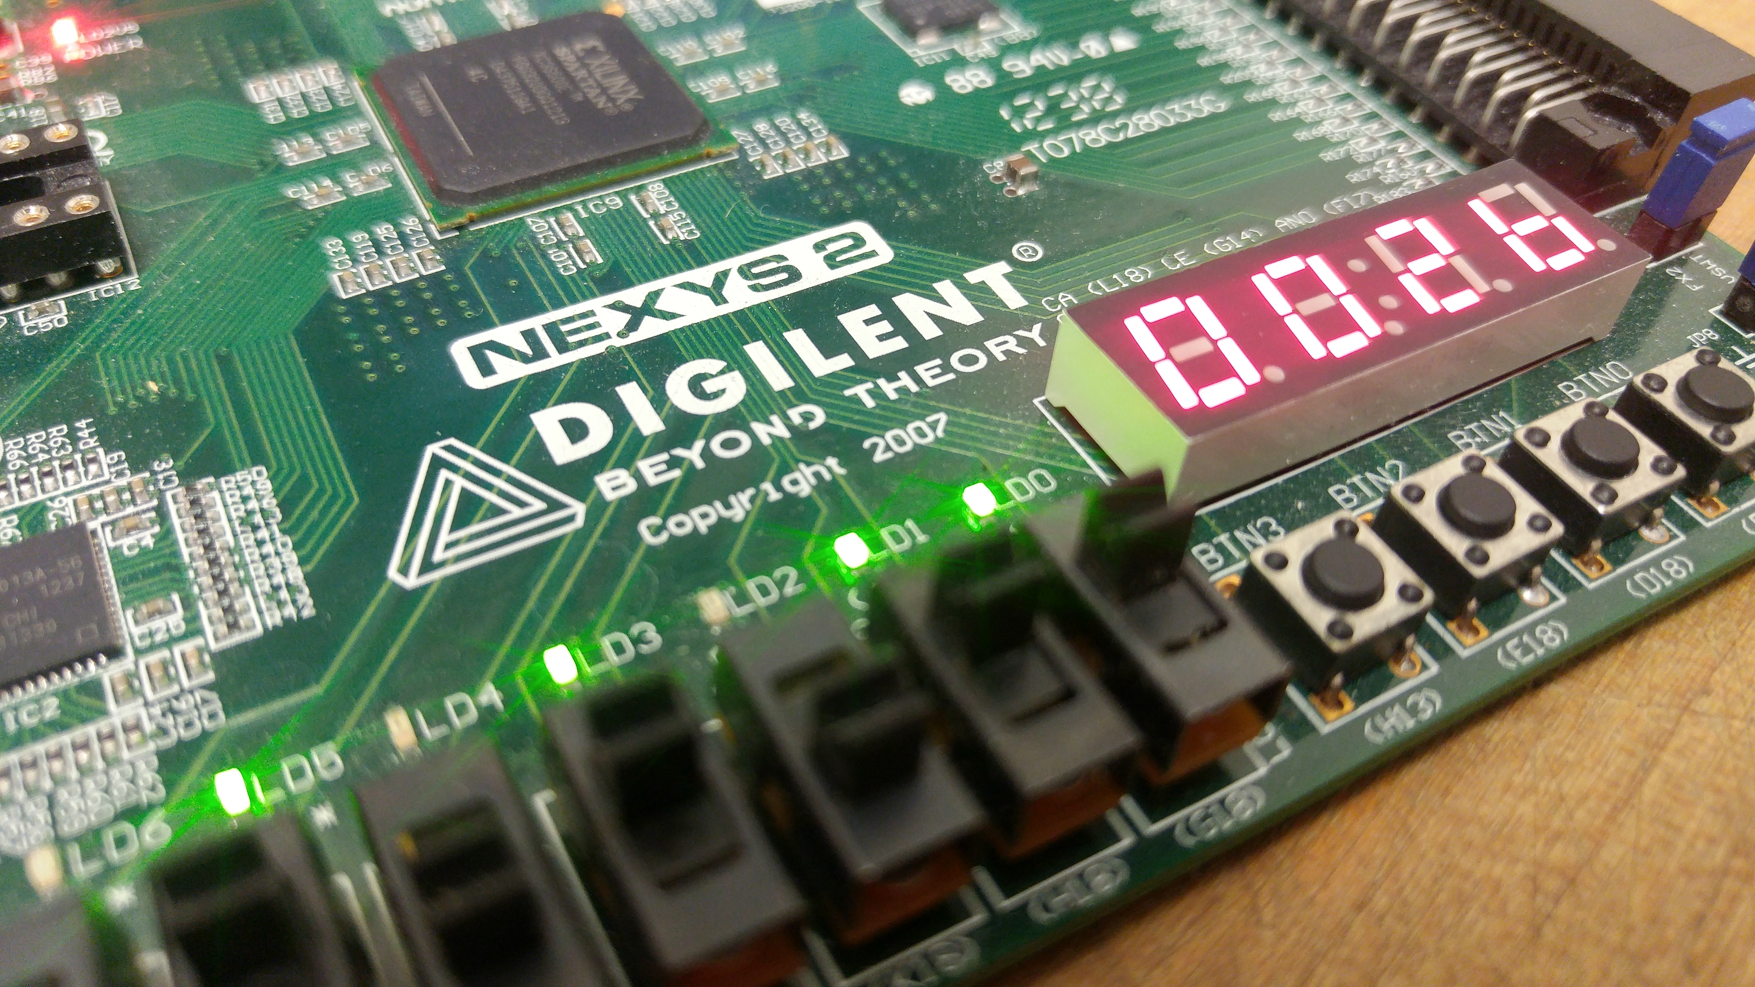
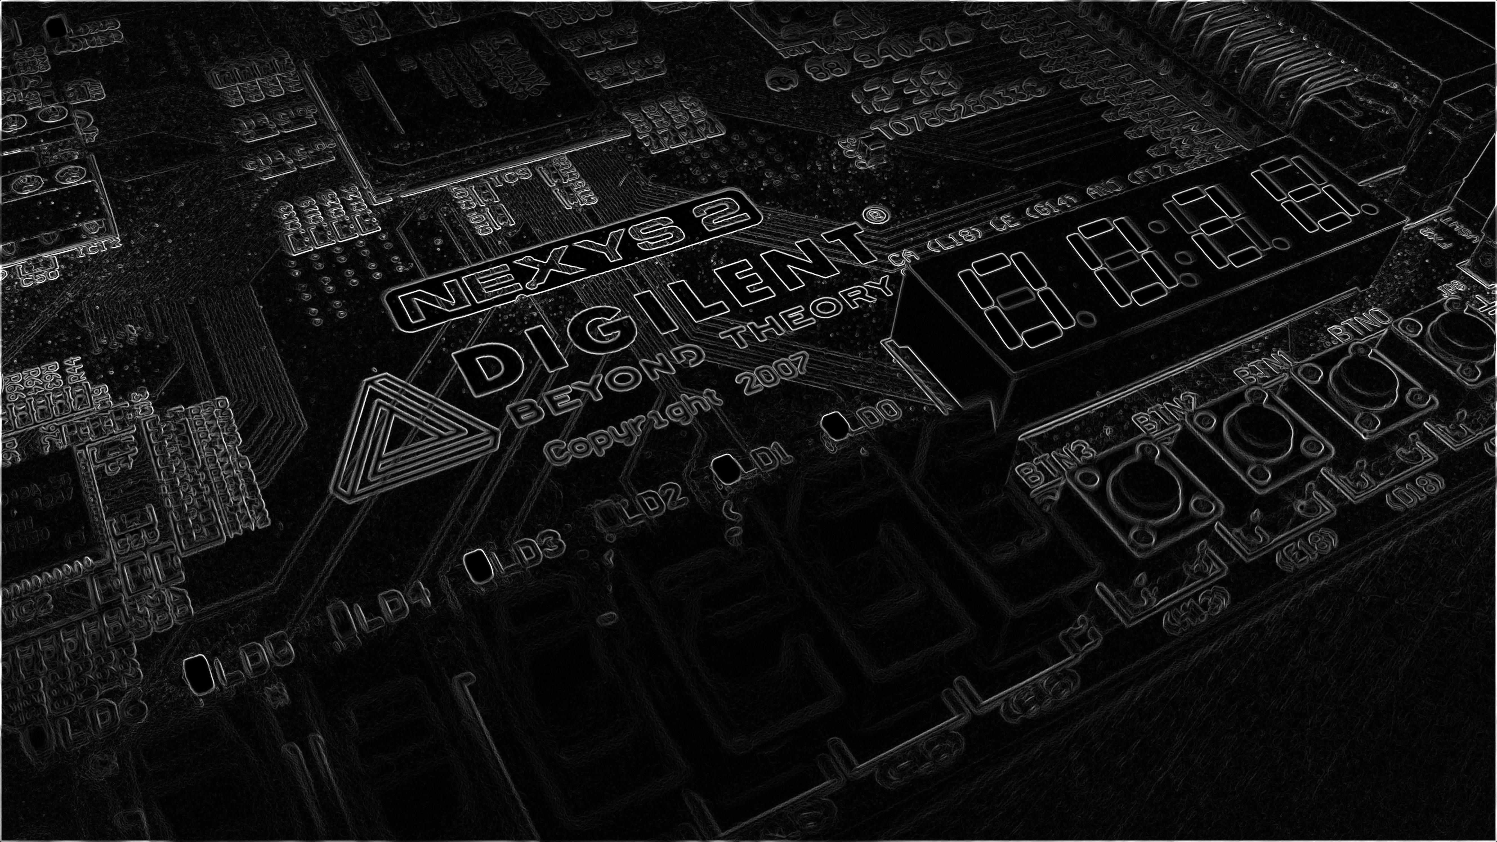
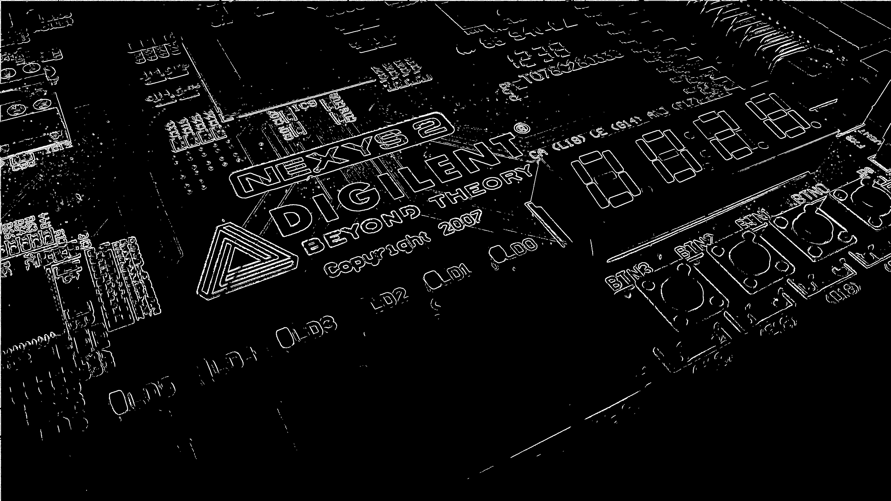
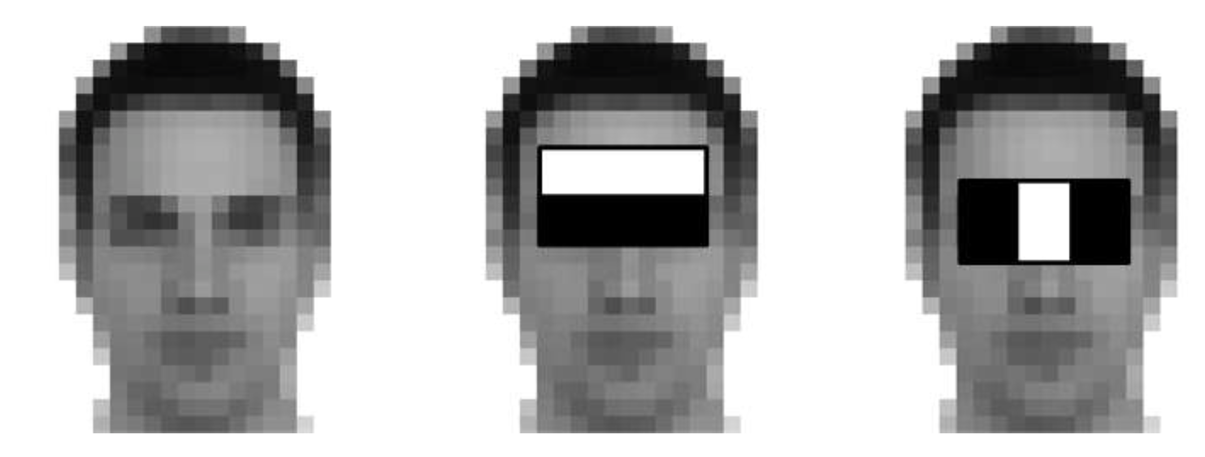
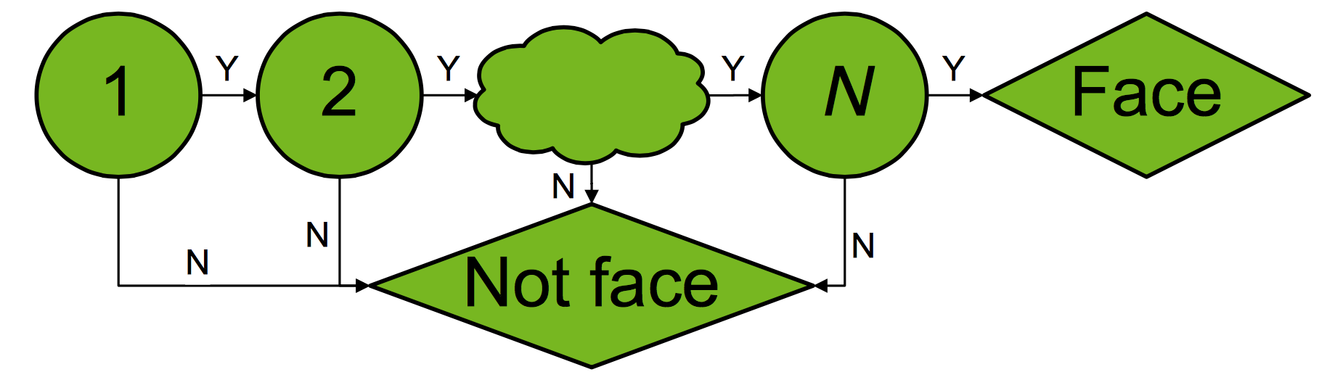
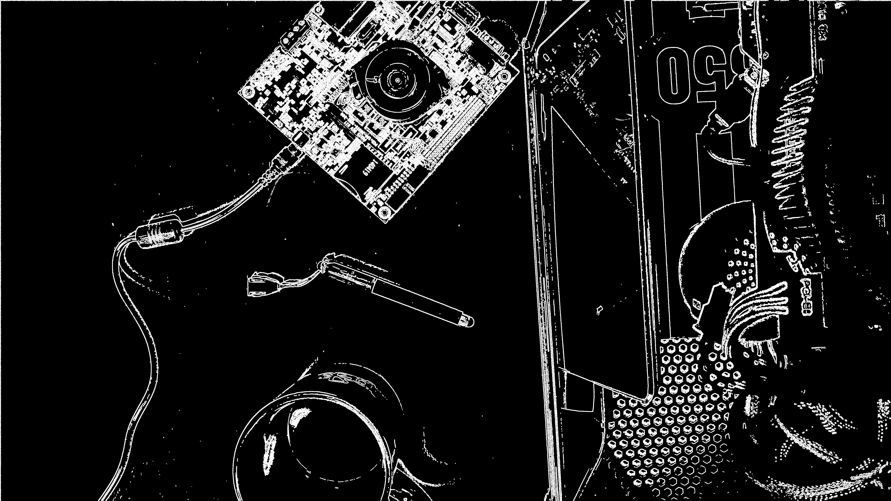

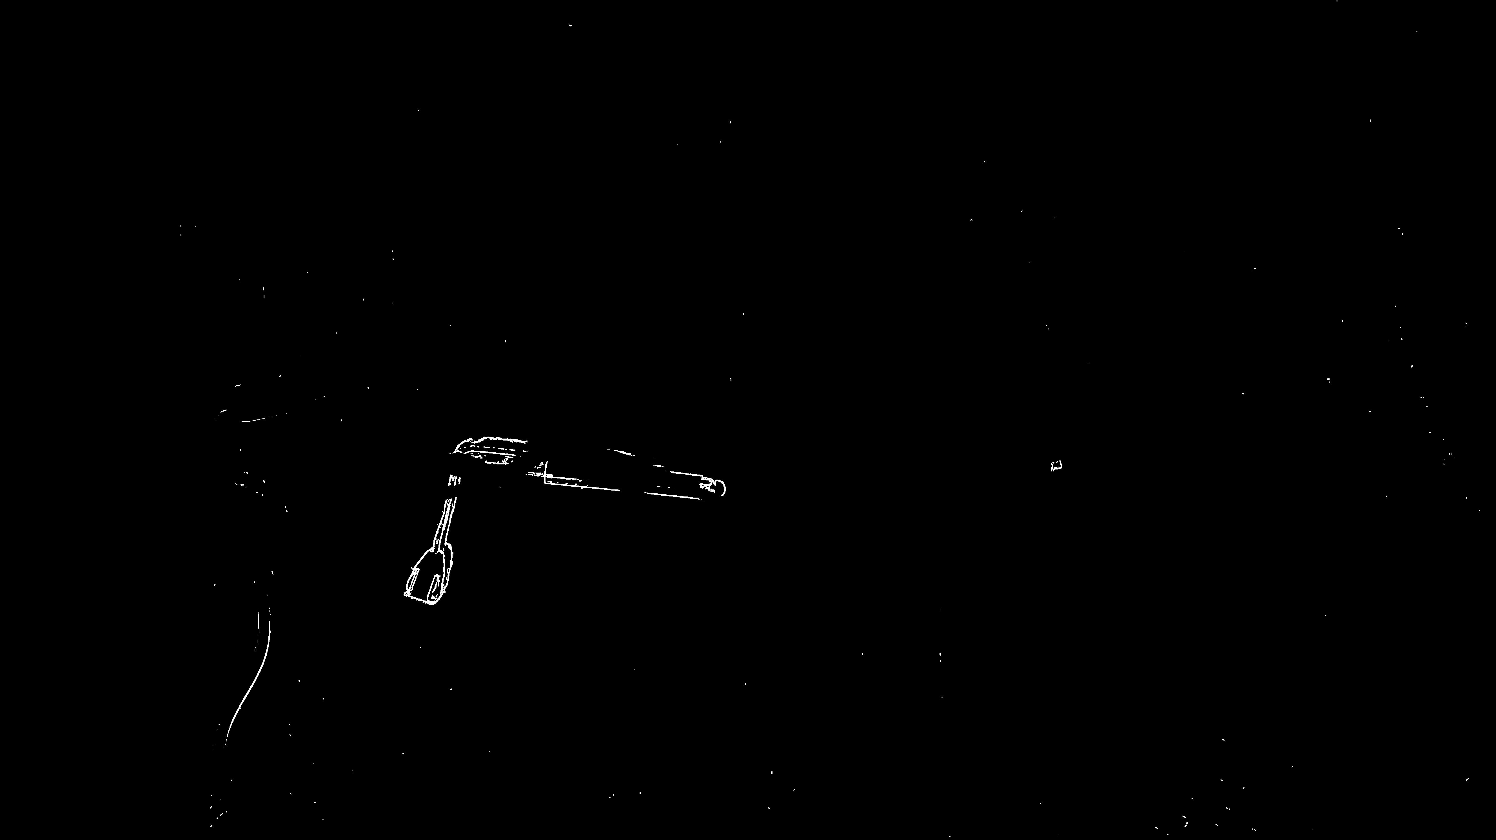
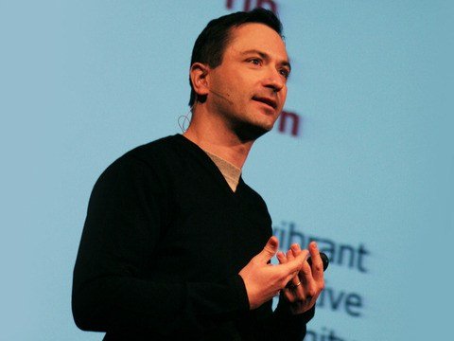
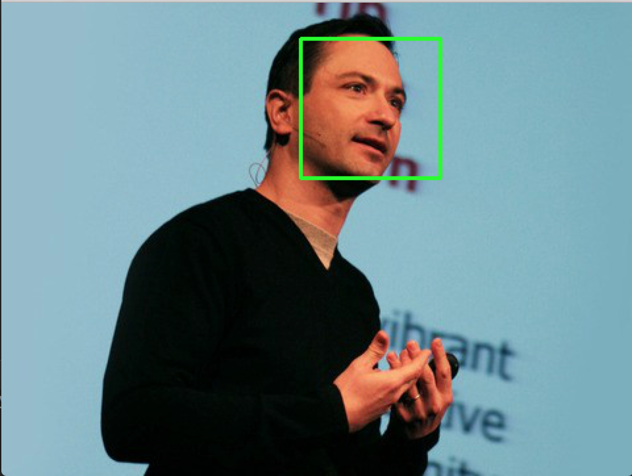
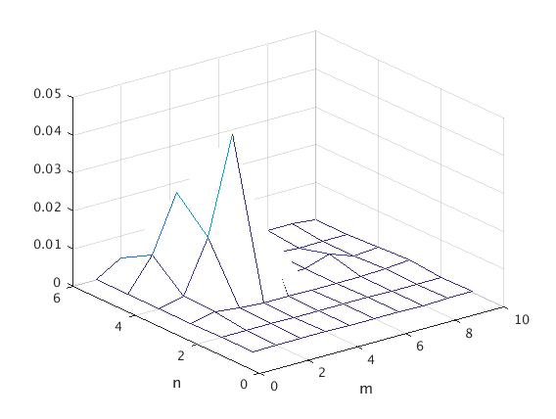

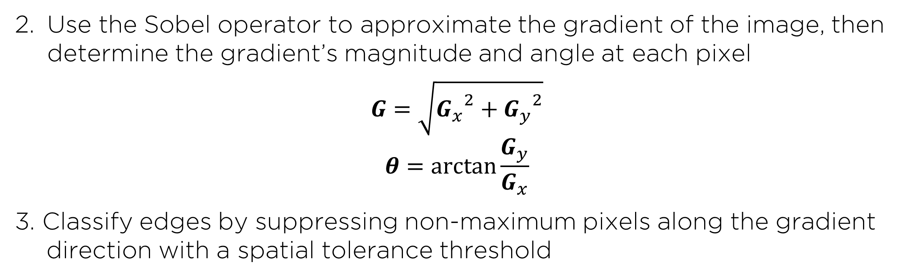
GPU-Accelerated Parallelization of
Common Computer Vision Applications
Emilio Del Vecchio, Kevin Lin, Senthil S. Natarajan
Department of Electrical and Computer Engineering, Rice University
I. INTRODUCTION
III. EDGE DETECTION
V. GPU SPEEDUP RESULTS
-Graphics Processing Units (GPU’s) are powerful tools for parallelized computations on large data inputs, achieving massive speedups over a serial CPU
Reduce high frequency noise from the image with a Gaussian blur
-We implemented our algorithms in C using the CUDA framework. The results below were obtained on a Intel Core i5 4200U CPU and an NVIDIA GeForce GTX 860M GPU.
VS
Fig 1. Massively parallel GPU architecture compared to a multicore CPU
Fig 5. FFT of grayscale noisy image, unfiltered (left) versus filtered (right)
-NVIDIA CUDA (Compute Unified Device Architecture) exposes simple C-based APIs for GPU computation
-Our objective: utilize the GPU’s ability to accelerate computer vision applications like facial recognition, edge detection, and motion tracking
-Existing computer vision algorithms, when parallelized with CUDA, run several times faster than on a CPU
Use the Sobel operator to approximate the gradient of the image, then determine the gradient’s magnitude and angle at each pixel
$$G=\sqrt{{G_{x}}^{2}+{G_{y}}^{2}}$$
$$θ=\arctan{\frac{G_{y}}{G_{x}}}$$
3. Classify edges by suppressing non-maximum pixels along the gradient direction with a spatial tolerance threshold
II. FACIAL RECOGNITION
Extract HAAR features of a face from a set of positive and negative training images.
Fig 9. CUDA facial recognition (top) consistently achieved 1.1 to 5.1x speedup. CUDA edge detection (middle) achieved 5.2 – 10.3x speedup. CUDA motion tracking tracking (bottom) achieved 4.2– 9.5x speedup.
Fig 6. Original image (left), Sobel filter output (center), final edges (right)
VI. CONCLUSIONS
Fig 2. Example HAAR features of a random face
IV. MOTION DETECTION
-Generally, our algorithms demonstrated increasing speedup with pixel count because of the overhead associated with launching kernels on small input sizes. Deviations from this trend result from implementation techniques that have a greater memory footprint.
-Overall, the results demonstrated that GPUs offer a powerful solution to the rising data requirements of modern computational and signal processing problems.
Despite any trends or outliers, the GPU implementations consistently were faster than the CPU counterparts.
-Potential limitations include: CUDA memory optimization and usage of 3rd party libraries (especially with facial recognition).
2. Use Adaptive Boosting machine learning to train a multi-stage, or cascade, classifier, against positive and negative HAAR features.
Calculate a pixel-by-pixel difference map from the edges of two frames, applying movement tolerance thresholding in the process
Fig 3. Cascade Classifier training rejects most non-face regions early.
Fig 7. Two sequential frames in a video stream and the detected difference between them
3. Apply final cascade classifier to a loaded image. The OpenCV library provides modules to encapsulate this process.
Estimate the motion region from a difference density map
VII. ACKNOWLEDGEMENTS
Fig 4. Original sample image (left), detected faces (right)
Fig 8. Spatial density map (left), motion area estimation (right)
-We would like to thank CJ Barberan and Richard Baraniuk for their guidance and support in this project.

